Slide 1
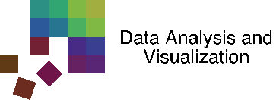
SMARTexplore: Simplifying High-Dimensional Data Analysis through a Table-Based Visual Analytics Approach
M. Blumenschein, M. Behrisch, S. Schmid, S. Butscher,
D. R. Wahl, K. Villinger, B. Renner, H. Reiterer, and D. A. Keim
University of Konstanz, Germany Harvard University, USA
Notes:
SMARTexplore, novel, table-based VA approach to Identify and understand, clusters, correlations, and complex patters in HD
Result of 3 year collaboration (health psychologists)
----------------------------------------------------------------------------------------------------------------
TALK GIVEN @ IEEE VAST (http://ieeevis.org/year/2018/info/call-participation/vast-paper-types) on 2018-10-25
If you find it useful, please cite as follows
Blumenschein, Michael, et al. "SMARTexplore: Simplifying High-Dimensional Data Analysis through a Table-Based Visual Analytics Approach." IEEE Conference on Visual Analytics Science and Technology (VAST) (2018)
BibTex
@inproceedings{blumenschein2018smartexplore,
title={SMARTexplore: Simplifying High-Dimensional Data Analysis through a Table-Based Visual Analytics Approach},
author={Blumenschein, Michael and Behrisch, Michael and Schmid, Stefanie and Butscher, Simon and Wahl, Deborah R and Villinger, Karoline and Renner, Britta and Reiterer, Harald and Keim, Daniel A},
booktitle={IEEE Conference on Visual Analytics Science and Technology (VAST) 2018},
year={2018}
}

Slide 2
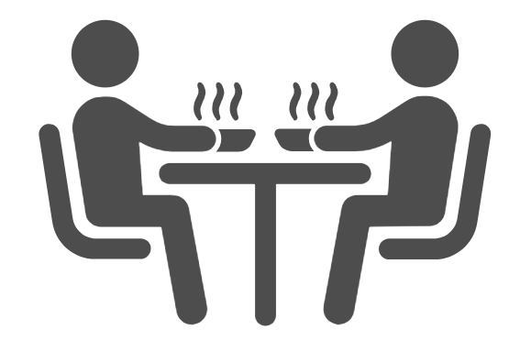
What influences the heating behavior of people?
What do people eat?
Health Psychologists
Motives for particular dish?
Peter
Emma
Impact of surrounding?
Notes:
Application, task, data which started collaboration.
2 health psych. Emma, Peter; Their primary research question is:
What do people eat?
How much
Which motives do they have to eat a particular dish?
Does the surrounding like with whom you eat, where you eat, and when you eat, influence the eating behavior?
And ultimately: what is the relation to health and how can we help to support a healthier food consumption?

Slide 3
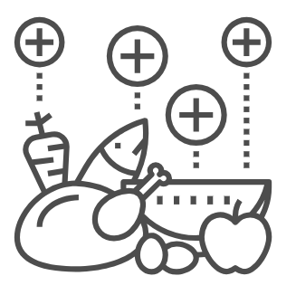
Background and Dataset
99 participants
2,571 meals
motives + surroundings
manual extraction of nutrition + ingredients
id | sex | age | bmi | meal type | day | where | with whom | mood before | mood after | … | … | fish | meat | milk | eggs | …
0 | m | 35 | 35.4 | breakfast | mo | home | alone | 1 | 2 | … | … | n | n | y | y | …
1 | m | 36 | 35.4 | lunch | mo | restaur | friends | 4 | 4 | … | … | y | n | y | y | …
2 | f | 55 | 28.3 | breakfast | tu | home | family | 2 | 3 | … | … | n | y | y | n | …
3 | f | 66 | 28.2 | tea | we | work | colleg. | 3 | 2 | … | … | n | n | n | n | …
4 | f | 25 | 28.2 | tea | th | work | colleg. | 1 | 1 | … | … | n | n | n | n | …
5 | f | 62 | 28.2 | supper | fr | work | family | 2 | 3 | … | … | y | n | y | n | …
6 | m | 53 | 24.7 | snack | sa | friends | friends | 4 | 4 | … | … | n | y | n | y | …
… | … | … | … | … | … | … | … | … | … | … | … | … | … | … | … | …
Notes:
Capture and analyze the real eating behavior – super interesting dataset
Participants of a large-scale study – capture every meal
by taking a picture,
Answer questions about their surroundings and motives
Peter and Emma, our domain experts , manually extracted the nutrition and ingredients added it to the dataset.

Slide 4
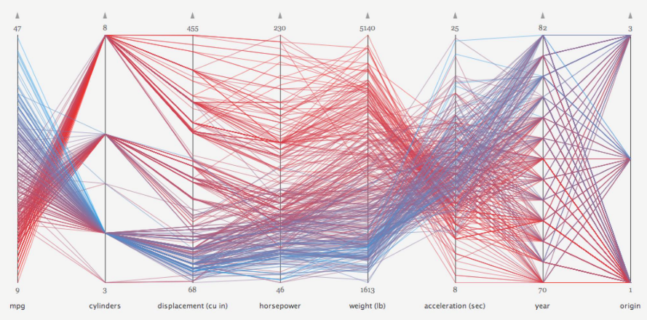
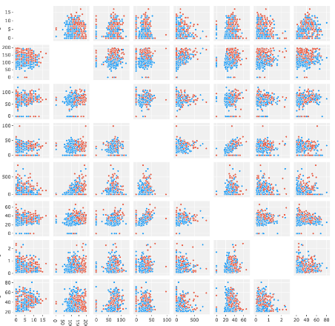
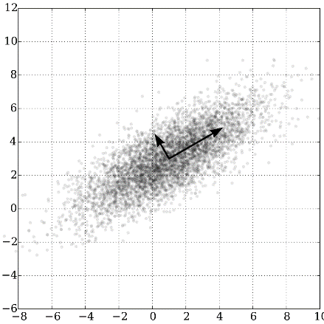
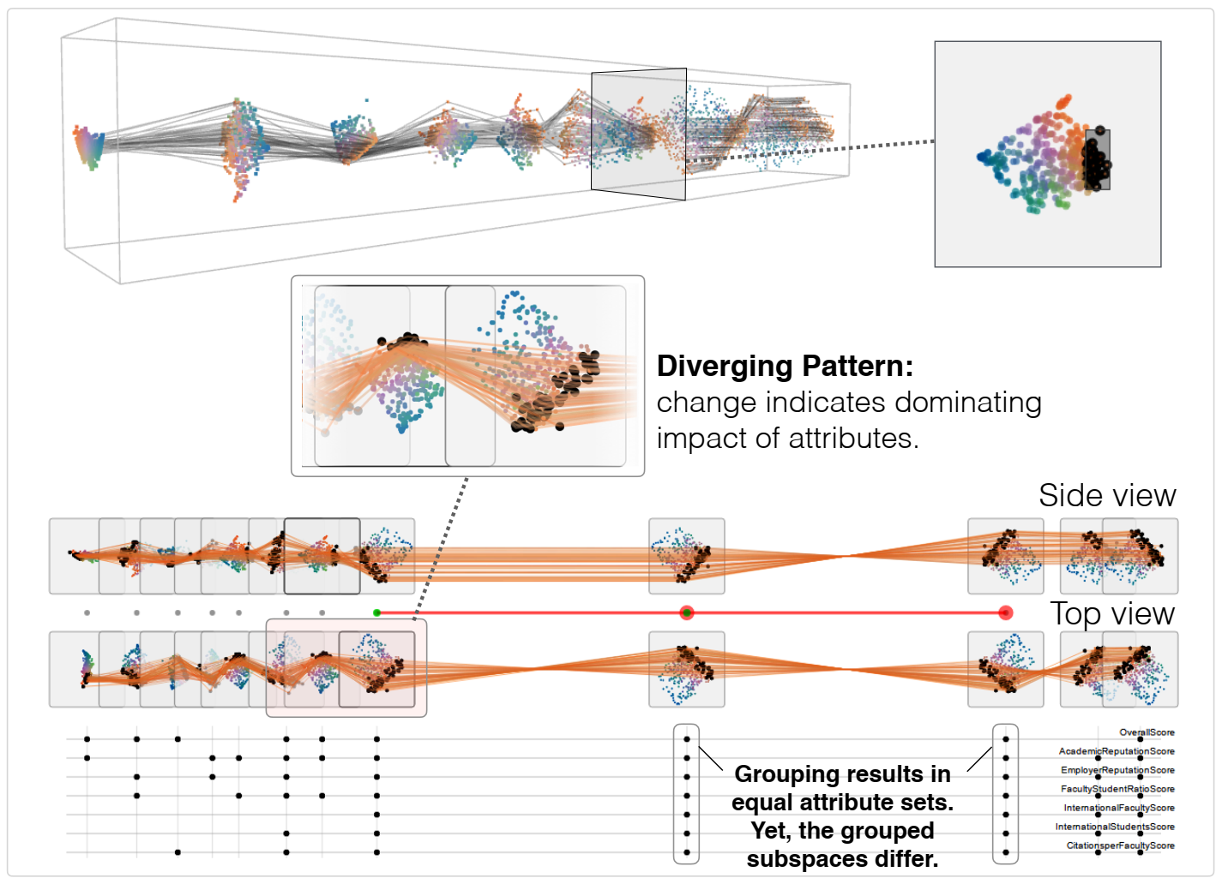
id | sex | age | bmi | meal type | day | where | with whom | mood before | mood after | … | … | fish | meat | milk | eggs | …
0 | m | 35 | 35.4 | breakfast | mo | home | alone | 1 | 2 | … | … | n | n | y | y | …
1 | m | 36 | 35.4 | lunch | mo | restaur | friends | 4 | 4 | … | … | y | n | y | y | …
2 | f | 55 | 28.3 | breakfast | tu | home | family | 2 | 3 | … | … | n | y | y | n | …
3 | f | 66 | 28.2 | tea | we | work | colleg. | 3 | 2 | … | … | n | n | n | n | …
4 | f | 25 | 28.2 | tea | th | work | colleg. | 1 | 1 | … | … | n | n | n | n | …
5 | f | 62 | 28.2 | supper | fr | work | family | 2 | 3 | … | … | y | n | y | n | …
6 | m | 53 | 24.7 | snack | sa | friends | friends | 4 | 4 | … | … | n | y | n | y | …
… | … | … | … | … | … | … | … | … | … | … | … | … | … | … | … | …
id | sex | age | bmi | meal type | day | where | with whom | mood before | mood after | … | … | fish | meat | milk | eggs | …
0 | m | 35 | 35.4 | breakfast | mo | home | alone | 1 | 2 | … | … | n | n | y | y | …
1 | m | 36 | 35.4 | lunch | mo | restaur | friends | 4 | 4 | … | … | y | n | y | y | …
2 | f | 55 | 28.3 | breakfast | tu | home | family | 2 | 3 | … | … | n | y | y | n | …
3 | f | 66 | 28.2 | tea | we | work | colleg. | 3 | 2 | … | … | n | n | n | n | …
4 | f | 25 | 28.2 | tea | th | work | colleg. | 1 | 1 | … | … | n | n | n | n | …
5 | f | 62 | 28.2 | supper | fr | work | family | 2 | 3 | … | … | y | n | y | n | …
6 | m | 53 | 24.7 | snack | sa | friends | friends | 4 | 4 | … | … | n | y | n | y | …
… | … | … | … | … | … | … | … | … | … | … | … | … | … | … | … | …
categorical
numerical
binary
Parallel Coordinates
Scatter Plot (Matrix)
Projection
Subspace Analysis
https://datavizproject.com/data-type/parallel-coordinates/
https://plotlyblog.tumblr.com/post/174657459542/what-is-a-splom-chart-making-scatterplot-matrices
https://en.wikipedia.org/wiki/Principal_component_analysis
Jäckle et al. Pattern Trails: Visual Analysis of Pattern Transitions in Subspaces (VAST 2017)
Notes:
Dataset; not too many records, more than 50 dimensions
Vis perspective – difficult/interesting – dimensions form semantic groups + mixture of numerical/categorical/binary features.
Started collaboration: applying state-of-the-art techniques for MD and HD such as PCP, SP, SPLOM, linear and non-linear projections

Slide 5
id | sex | age | bmi | meal type | day | where | with whom | mood before | mood after | … | … | fish | meat | milk | eggs | …
0 | m | 35 | 35.4 | breakfast | mo | home | alone | 1 | 2 | … | … | n | n | y | y | …
1 | m | 36 | 35.4 | lunch | mo | restaur | friends | 4 | 4 | … | … | y | n | y | y | …
2 | f | 55 | 28.3 | breakfast | tu | home | family | 2 | 3 | … | … | n | y | y | n | …
3 | f | 66 | 28.2 | tea | we | work | colleg. | 3 | 2 | … | … | n | n | n | n | …
4 | f | 25 | 28.2 | tea | th | work | colleg. | 1 | 1 | … | … | n | n | n | n | …
5 | f | 62 | 28.2 | supper | fr | work | family | 2 | 3 | … | … | y | n | y | n | …
6 | m | 53 | 24.7 | snack | sa | friends | friends | 4 | 4 | … | … | n | y | n | y | …
… | … | … | … | … | … | … | … | … | … | … | … | … | … | … | … | …
id | sex | age | bmi | meal type | day | where | with whom | mood before | mood after | … | … | fish | meat | milk | eggs | …
0 | m | 35 | 35.4 | breakfast | mo | home | alone | 1 | 2 | … | … | n | n | y | y | …
1 | m | 36 | 35.4 | lunch | mo | restaur | friends | 4 | 4 | … | … | y | n | y | y | …
2 | f | 55 | 28.3 | breakfast | tu | home | family | 2 | 3 | … | … | n | y | y | n | …
3 | f | 66 | 28.2 | tea | we | work | colleg. | 3 | 2 | … | … | n | n | n | n | …
4 | f | 25 | 28.2 | tea | th | work | colleg. | 1 | 1 | … | … | n | n | n | n | …
5 | f | 62 | 28.2 | supper | fr | work | family | 2 | 3 | … | … | y | n | y | n | …
6 | m | 53 | 24.7 | snack | sa | friends | friends | 4 | 4 | … | … | n | y | n | y | …
… | … | … | … | … | … | … | … | … | … | … | … | … | … | … | … | …
change mental model
check findings
statistic validation
Parallel Coordinates
Scatter Plot (Matrix)
Projection
Subspace Analysis
https://datavizproject.com/data-type/parallel-coordinates/
https://plotlyblog.tumblr.com/post/174657459542/what-is-a-splom-chart-making-scatterplot-matrices
https://en.wikipedia.org/wiki/Principal_component_analysis
Jäckle et al. Pattern Trails: Visual Analysis of Pattern Transitions in Subspaces (VAST 2017)
Notes:
Daily usage: Excel, SPSS
Change mental model: from original representation (table) and abstract representation
Back to the table to check findings and statistic validation

Slide 6
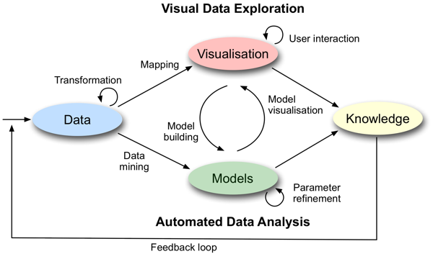
id | sex | age | bmi | meal type | day | where | with whom | mood before | mood after | … | … | fish | meat | milk | eggs | …
0 | m | 35 | 35.4 | breakfast | mo | home | alone | 1 | 2 | … | … | n | n | y | y | …
1 | m | 36 | 35.4 | lunch | mo | restaur | friends | 4 | 4 | … | … | y | n | y | y | …
2 | f | 55 | 28.3 | breakfast | tu | home | family | 2 | 3 | … | … | n | y | y | n | …
3 | f | 66 | 28.2 | tea | we | work | colleg. | 3 | 2 | … | … | n | n | n | n | …
4 | f | 25 | 28.2 | tea | th | work | colleg. | 1 | 1 | … | … | n | n | n | n | …
5 | f | 62 | 28.2 | supper | fr | work | family | 2 | 3 | … | … | y | n | y | n | …
6 | m | 53 | 24.7 | snack | sa | friends | friends | 4 | 4 | … | … | n | y | n | y | …
… | … | … | … | … | … | … | … | … | … | … | … | … | … | … | … | …
Automatic handling and aggregation of mixed data types
Simplification of complex data transformations
Automatic pattern identification and highlighting
Automated reliability analysis (of visual patterns)
Keim, Daniel, et al. "Visual analytics: Definition, process, and challenges." Information visualization. Springer, Berlin, Heidelberg, 2008. 154-175.
Notes:
Why not go the other way round?
Instead mapping data to abstract representations, we inject VA concepts into the table format.
13 requirements for table-based VA approaches which supports identification and understanding of patterns
Based on these requirements, we developed SMARTexplore with the following main features.

Slide 7
id | sex | age | bmi
0 | m | 35 | 35.4
1 | m | 36 | 35.4
2 | f | 55 | 28.3
3 | f | 66 | 28.2
4 | f | 25 | 28.2
5 | f | 62 | 28.2
6 | m | 53 | 24.7
… | … | … | …
id | sex | age | bmi | meal type | day | where | with whom | mood before | mood after | fish | meat | milk | eggs | …
0 | m | 35 | 35.4 | breakfast | mo | home | alone | 1 | 2 | n | n | y | y | …
1 | m | 36 | 35.4 | lunch | mo | restaur | friends | 4 | 4 | y | n | y | y | …
2 | f | 55 | 28.3 | breakfast | tu | home | family | 2 | 3 | n | y | y | n | …
3 | f | 66 | 28.2 | tea | we | work | colleg. | 3 | 2 | n | n | n | n | …
4 | f | 25 | 28.2 | tea | th | work | colleg. | 1 | 1 | n | n | n | n | …
5 | f | 62 | 28.2 | supper | fr | work | family | 2 | 3 | y | n | y | n | …
6 | m | 53 | 24.7 | snack | sa | friends | friends | 4 | 4 | n | y | n | y | …
… | … | … | … | … | … | … | … | … | … | … | … | … | … | …
meal type | day | where | with whom | mood before | mood after
breakfast | mo | home | alone | 1 | 2
lunch | mo | restaur | friends | 4 | 4
breakfast | tu | home | family | 2 | 3
tea | we | work | colleg. | 3 | 2
tea | th | work | colleg. | 1 | 1
supper | fr | work | family | 2 | 3
snack | sa | friends | friends | 4 | 4
… | … | … | … | … | …
fish | meat | milk | eggs | …
n | n | y | y | …
y | n | y | y | …
n | y | y | n | …
n | n | n | n | …
n | n | n | n | …
y | n | y | n | …
n | y | n | y | …
… | … | … | … | …
Subspace A
Subspace B
Subspace C
Notes:
Idea of SMARTexplore: simple
Dimensions can be grouped into semantically meaningful subspaces.
Either manually by domain knowledge or pattern-driven by a clustering algorithm

Slide 8
id | sex | age | bmi
0 | m | 35 | 35.4
1 | m | 36 | 35.4
meal type | day | where | with whom | mood before | mood after
breakfast | mo | home | alone | 1 | 2
lunch | mo | restaur | friends | 4 | 4
fish | meat | milk | eggs | …
n | n | y | y | …
y | n | y | y | …
G1
id | sex | age | bmi
0 | m | 35 | 35.4
1 | m | 36 | 35.4
2 | f | 55 | 28.3
3 | f | 66 | 28.2
4 | f | 25 | 28.2
5 | f | 62 | 28.2
6 | m | 53 | 24.7
… | … | … | …
meal type | day | where | with whom | mood before | mood after
breakfast | mo | home | alone | 1 | 2
lunch | mo | restaur | friends | 4 | 4
breakfast | tu | home | family | 2 | 3
tea | we | work | colleg. | 3 | 2
tea | th | work | colleg. | 1 | 1
supper | fr | work | family | 2 | 3
snack | sa | friends | friends | 4 | 4
… | … | … | … | … | …
fish | meat | milk | eggs | …
n | n | y | y | …
y | n | y | y | …
n | y | y | n | …
n | n | n | n | …
n | n | n | n | …
y | n | y | n | …
n | y | n | y | …
… | … | … | … | …
G2
2 | f | 55 | 28.3
3 | f | 66 | 28.2
4 | f | 25 | 28.2
5 | f | 62 | 28.2
breakfast | tu | home | family | 2 | 3
tea | we | work | colleg. | 3 | 2
tea | th | work | colleg. | 1 | 1
supper | fr | work | family | 2 | 3
n | y | y | n | …
n | n | n | n | …
n | n | n | n | …
y | n | y | n | …
6 | m | 53 | 24.7
… | … | … | …
snack | sa | friends | friends | 4 | 4
… | … | … | … | … | …
n | y | n | y | …
… | … | … | … | …
G3
Subspace A
Subspace B
Subspace C
Notes:
Data records can be grouped into clusters, e.g., by
A clustering algorithm
Given categories
Binning of numerical dimensions
Domain knowledge

Slide 9
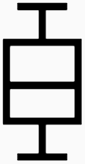
id | sex | age | bmi
0 | m | 35 | 35.4
1 | m | 36 | 35.4
meal type | day | where | with whom | mood before | mood after
breakfast | mo | home | alone | 1 | 2
lunch | mo | restaur | friends | 4 | 4
fish | meat | milk | eggs | …
n | n | y | y | …
y | n | y | y | …
G1
G2
2 | f | 55 | 28.3
3 | f | 66 | 28.2
4 | f | 25 | 28.2
5 | f | 62 | 28.2
breakfast | tu | home | family | 2 | 3
tea | we | work | colleg. | 3 | 2
tea | th | work | colleg. | 1 | 1
supper | fr | work | family | 2 | 3
n | y | y | n | …
n | n | n | n | …
n | n | n | n | …
y | n | y | n | …
SMARTable
G3
6 | m | 53 | 24.7
… | … | … | …
snack | sa | friends | friends | 4 | 4
… | … | … | … | … | …
n | y | n | y | …
… | … | … | … | …
Subspace A
Subspace B
Subspace C
Notes:
For each cluster / dimension combination → aggregated value → descriptor
For categorical data: for example frequency distribution
For numerical data: statistics such as mean, variance, or standard deviation
For binary: ratio between true/false
Of course: subspaces with mixed dimensions exist
We call this structured table with aggregated features a SMARTable.

Slide 10
Comparison of different meal types
mean
Records are grouped by meal type
Semantic grouping of dimensions
Notes:
First, very simple view of our tool SMARTexplore
Meals are grouped by their type (breakfast, lunch, supper, coffee break, snack)
Dimensions are grouped by their semantic meaning (nutrition, ingredients, motives, and so on)
Mostly numerical dimensions -> mean value is represented
Dark red -> high value, white -> low mean value

Slide 11
Comparison of different meal types
mean
Records are grouped by meal type
Semantic grouping of dimensions
Notes:
Breakfast has the highest amount of sugar and carbohydrate

Slide 12
Comparison of different meal types
mean
Records are grouped by meal type
Semantic grouping of dimensions
Notes:
In consists mainly of
Milk products
Cereals
Fruites
And Candy

Slide 13
Comparison of different meal types
mean
Records are grouped by meal type
Semantic grouping of dimensions
Notes:
And the main reasons participants consumed these meals are
An established habit
Natural concerns
Health and weight control

Slide 14
Comparison of different meal types
mean
Records are grouped by meal type
Semantic grouping of dimensions
Notes:
For lunch and supper
Main ingredients are meat, vegetables, potatoes, fish
And interestingly a particular lunch has been selected by price, convenience and hunger

Slide 15
Comparison of different meal types
mean
Records are grouped by meal type
Semantic grouping of dimensions
Automatic sorting of dimensions by visual similarity or avg. descriptor
Notes:
Pattern only visible if dimensions / columns are sorted properly
We support
Sorting by visual similarity
Sorting by average descriptor
Also rows/columns combined using a matrix reordering algorithm

Slide 16
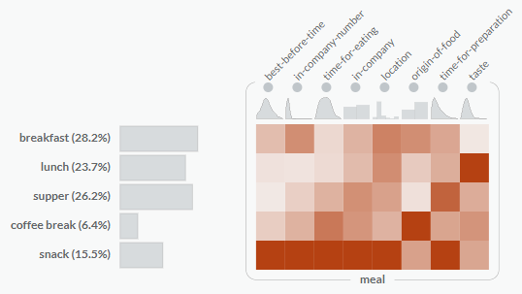
Subspace with mixed data types
high-value
- highest deviation from dimension taste
- but no information about the actual value
categorical dimension - value = Eucl. distance between frequency histograms
numerical + binary dimension - value = | mean_{group} – mean_{dimension} |
Notes:
SMARTexplore supports not only numerical data, but can also analyze subspaces with a mixture of different types.
Idea: do not encode the actual data descriptor, but the deviation or difference between a descriptor and the overall dimension.
For numerical and binary: mean between the group and the dimension
For categorical the difference between the frequency histograms.
Then map this to the colormap where dark color correspond to a high deviation
The red color in the last row means that snacks have the highest deviation for most dimensions of the subspace.
BUT, we do not know whether the values are high/low

Slide 17
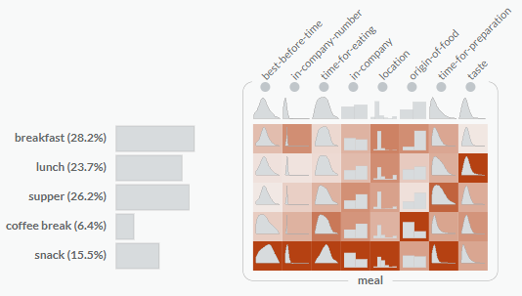
Subspace with mixed data types
categorical dimension - value = Eucl. distance between frequency histograms
numerical + binary dimension - value = | mean_{group} – mean_{dimension} |
Notes:
And then, Peter and Emma can investigate the actual values or distribution, e.g., by adding a overlay
They can see, for example, the different distributions.

Slide 18
Interaction within the SMARTable
Notes:
Interaction with SMARTable
Concept is based on commonly used tools like excel.
In the particular example, we want to investigate whether age affects eating behavior

Slide 19
Normalizing Strategies
Normalize per dimension -- Useful for dimension with different scale
Is there a difference
between male and female?
Normalize per subspace -- Useful for dimension with same scale
Notes:
SMARTexplore supports different normalizing strategies
Two examples
Linearly normalize per dimension
Allows to compare dimensions with a different scale
See for example that older people (last row) consume more fat, potatoes, fruits, etc than younger people
Linearly normalize per subspace
If dimensions have the same scale
Compare individual descriptors across the entire subspace
For example: motives in data: values between 1-4
Generally: pleasure, hunger, visual appealing and liking have the highest value but differ slightly among the different age groups.
Pulse = Hülsenfrucht

Slide 20
Drill-down: Stacked SMARTable
Is there a difference
between male and female?

Slide 21
Drill-down: Stacked SMARTable
Notes:
SMARTexplore supports a recursive drill-down
SMARTable will be converted into a Stacked SMARTable.
On the left, we can see that each age group is recursively grouped into female vs. male
Glyphs get a bit more complex
On the left, we see the original value for the age group
On the top-right: female per age group
Bottom-right: male per age group
Check whether glyph has a consistent color: male and female is identical
Or whether they are different.

Slide 22
Drill-down: Stacked SMARTable
Notes:
Here: female (top) eat more vegetables than male (bottom)
although the average value is rather in the middle

Slide 23
Similarity Search
Notes:
We can select this descriptor
And then perform a nearest neighbor search

Slide 24
Similarity Search
Notes:
SMARTexplore highlights the most similar patterns.
Degree of similarity can be adjusted using a slider (similar to entire dimensions)

Slide 25
Reliability of visual patterns
Notes:
University dataset
Missing values using texture
Tooltip
Table lens

Slide 26
Can we trust the patterns which we perceive?
Visible patterns
(linear) correlation between kcal and all nutrition
meals with low calories are related to the motive health and weight control and the ingredient is mainly fruits
Notes:
Can we trust the patterns which we perceive?
In this example: Grouped meals by calories
First row: low calorie meals, last row: high calorie meals
We can see the following patterns:
Correlation between calories and nutrition (middle subspace)
Meals with low calories with low calories are related to the motive health and weight control and the ingredient is mainly fruits.
But can we trust these patterns?
We implemented various overlays for missing values, tooltips and a table lens for detail analysis.
However, more interestingly, we look into statistics

Slide 27
Statistical significance of a dimension
Are all these descriptors significantly different from each other?
Typical example: ANOVA
Notes:
A typical test to answer this is computing an ANOVA.

Slide 28
Statistical significance of a descriptor
Is this descriptor significantly different from the entire dimension?
Typical example: t-test
Notes:
A typical test is a t-test.

Slide 29
Statistical significance of descriptors and dimensions
Notes:
We add visual overlays to mark statistical significance
Squares for significant descriptors
Green for significant dimensions
More possible encodings (see paper)
We can see that
the motives for low calories are statistically significant,
the different descriptors for nutrition as well,
but not the ingredient fruit

Slide 30
Assumption-based (automatic) selection of statistical test
Appropriate test is automatically selected by data/distribution properties
Based on the rules by Andy Field [1]
Similar rules for categorical and binary dimensions
[1] A. Field. Discovering statistics using IBM SPSS statistics. sage, 2013
Notes:
The main difficulty when computing statistics is the appropriate selection of the test
as it depends on various assumptions or preconditions,
such as data type, whether dimensions are normally distributed, and so on.
In this image, we see some of the rules for numerical dimensions with their preconditions based an Andy Field.
SMARTexplore checks all preconditions and automatically selects the right test for you, so you don’t have to check the appropriate test for every separate dimension.
Of course, users can overwrite this recommendation and “just” fix the test to their needs.

Slide 31
Future Work based on expert user feedback
Support hypothesis generation by including automatic algorithms e.g., subspace clustering
More data types e.g., time series, etc.
Layout flexibility change back and forth between classical approaches and the SMARTable
Data analytical provenance add explicit gallery view
Notes:
Ideas for future work are based on user feedback during the different evaluation sessions.
We already support different possibilities for data aggregation, including clustering on a subset of dimensions.
However, users need some hypothesis of the data to start the analysis.
We want to support the hypothesis generation and add algorithms which can propose aggregations and recommend useful clusters.
We want to add more data types, in particular time series.
Layout flexibility
Other visualizations such as scatter plots and parallel coordinates have great advantages as well.
So it would be nice to change back and forth between classical approaches and the SMARTable
Add analytical provenance by an explicit gallery view

Slide 32
https://smartexplore.dbvis.de
@mi_blumenschein
Notes:
Feel free to explore our online prototype, where you can upload your own data as well.
Or download a version to your machine.
The source code will be soon.

